Slide 1


“The Impact of Early Life Stress on Susceptibility and Severity of Symptoms of Coronavirus.”
ECHO Concept Proposal

Slide 2
Rationale and Structure
Rationale
Leveraging Echo
Thinking about our hormones data collection
This really needs to move forward quickly
Structure
How submission works
The original Idea
How that idea has evolved
Where that idea could be stronger

Slide 3
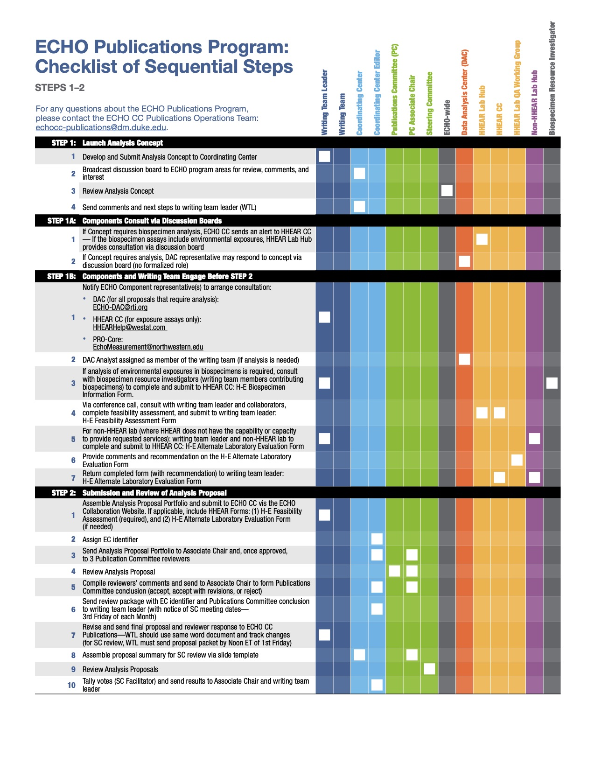
How This Works (In Theory)

Slide 4
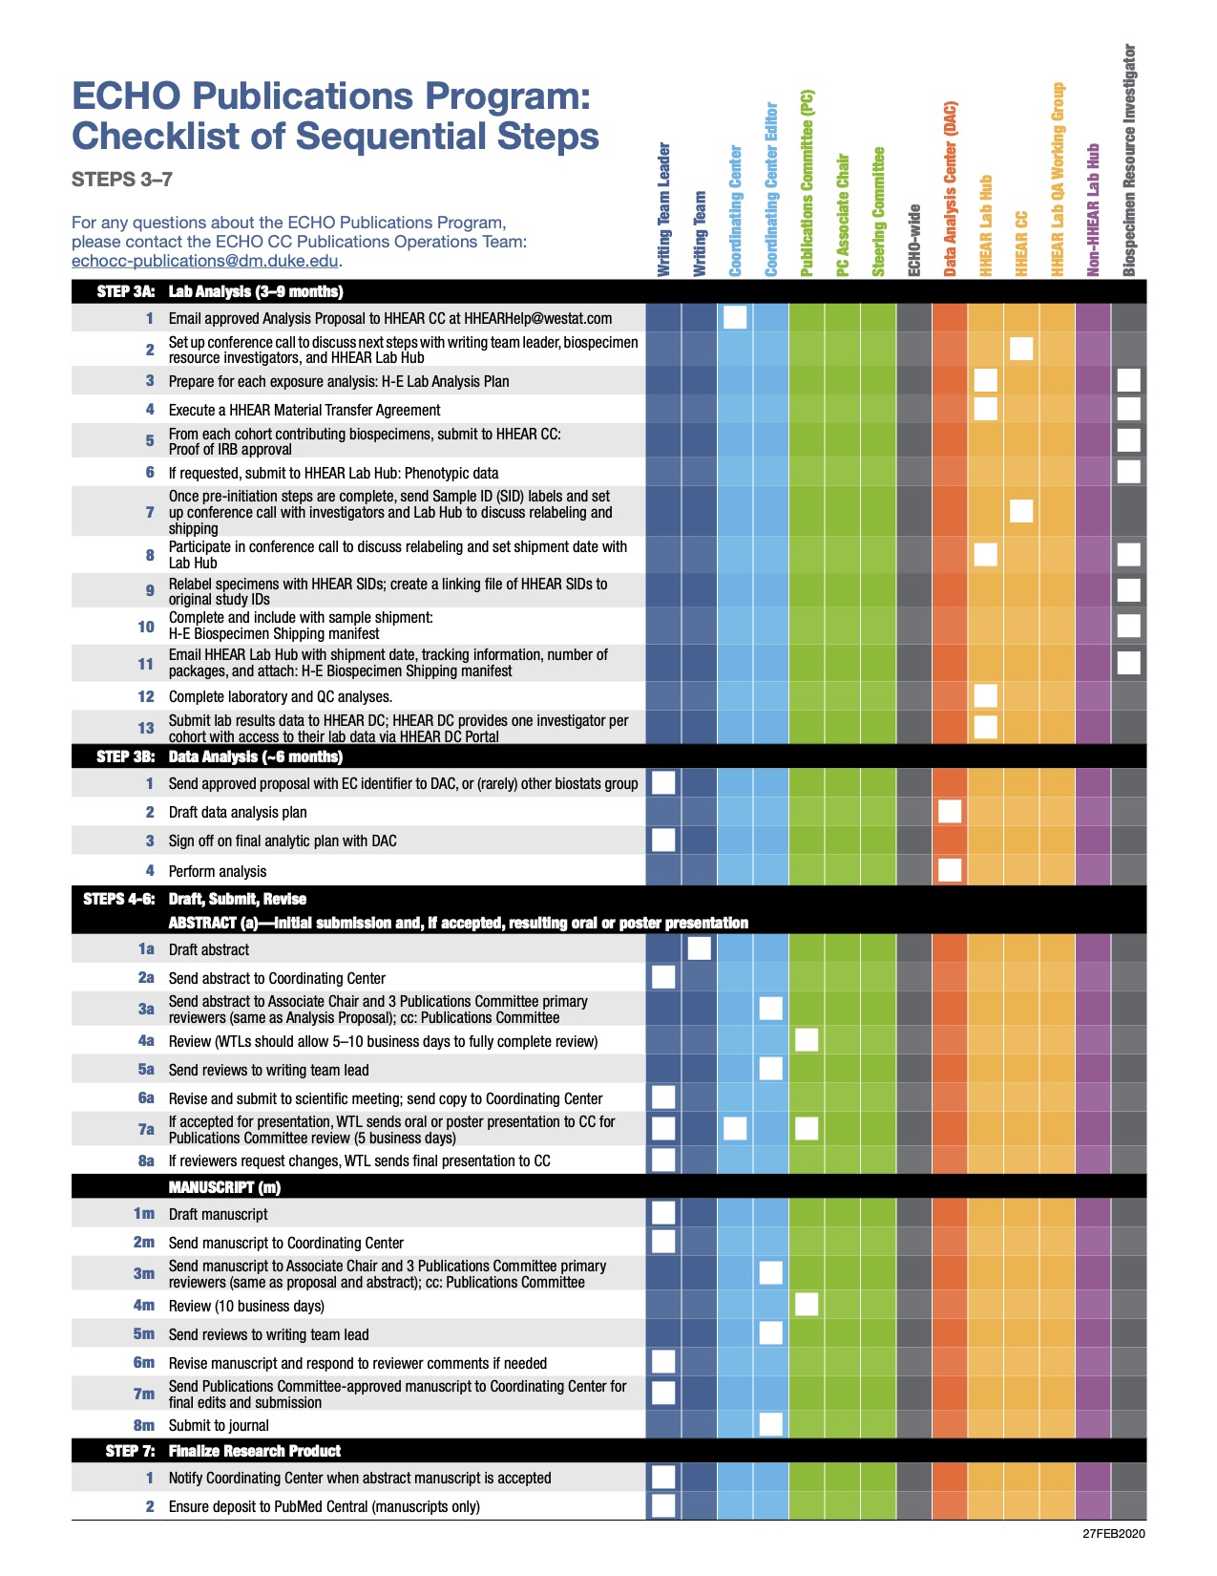
How This Works (In Theory)

Slide 7
“The impact of Early Life Stress on Susceptibility and Severity of Symptoms of Coronavirus.”
WHERE WE STARTED:
Hypothesis 1 : History of Early Life Adversity will predispose to susceptibility for COVID 19, and influence the severity of COVID 19 related symptoms .
Hypothesis 2 : Where one lives (rural/urban; neighborhood density) will moderate the potential association between Early Life Adversity and COVID 19 such that more dense neighborhoods will have stronger relationships between early life adversity and COVID 19 symptoms and severity.

Slide 8
What are we interested in?
COVID-19 Symptoms/Severity
Stress

Slide 9
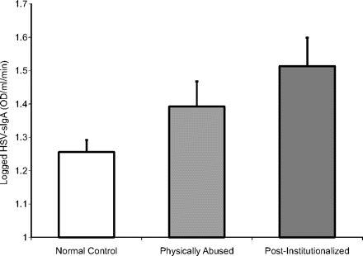
But…Why?
Early childhood stress is associated with elevated antibody levels to herpes simplex virus type 1
Elizabeth A. Shirtcliff, Christopher L. Coe, Seth D. Pollak
Proceedings of the National Academy of Sciences Feb 2009, 106 (8) 2963-2967; DOI:10.1073/pnas.0806660106

Slide 10
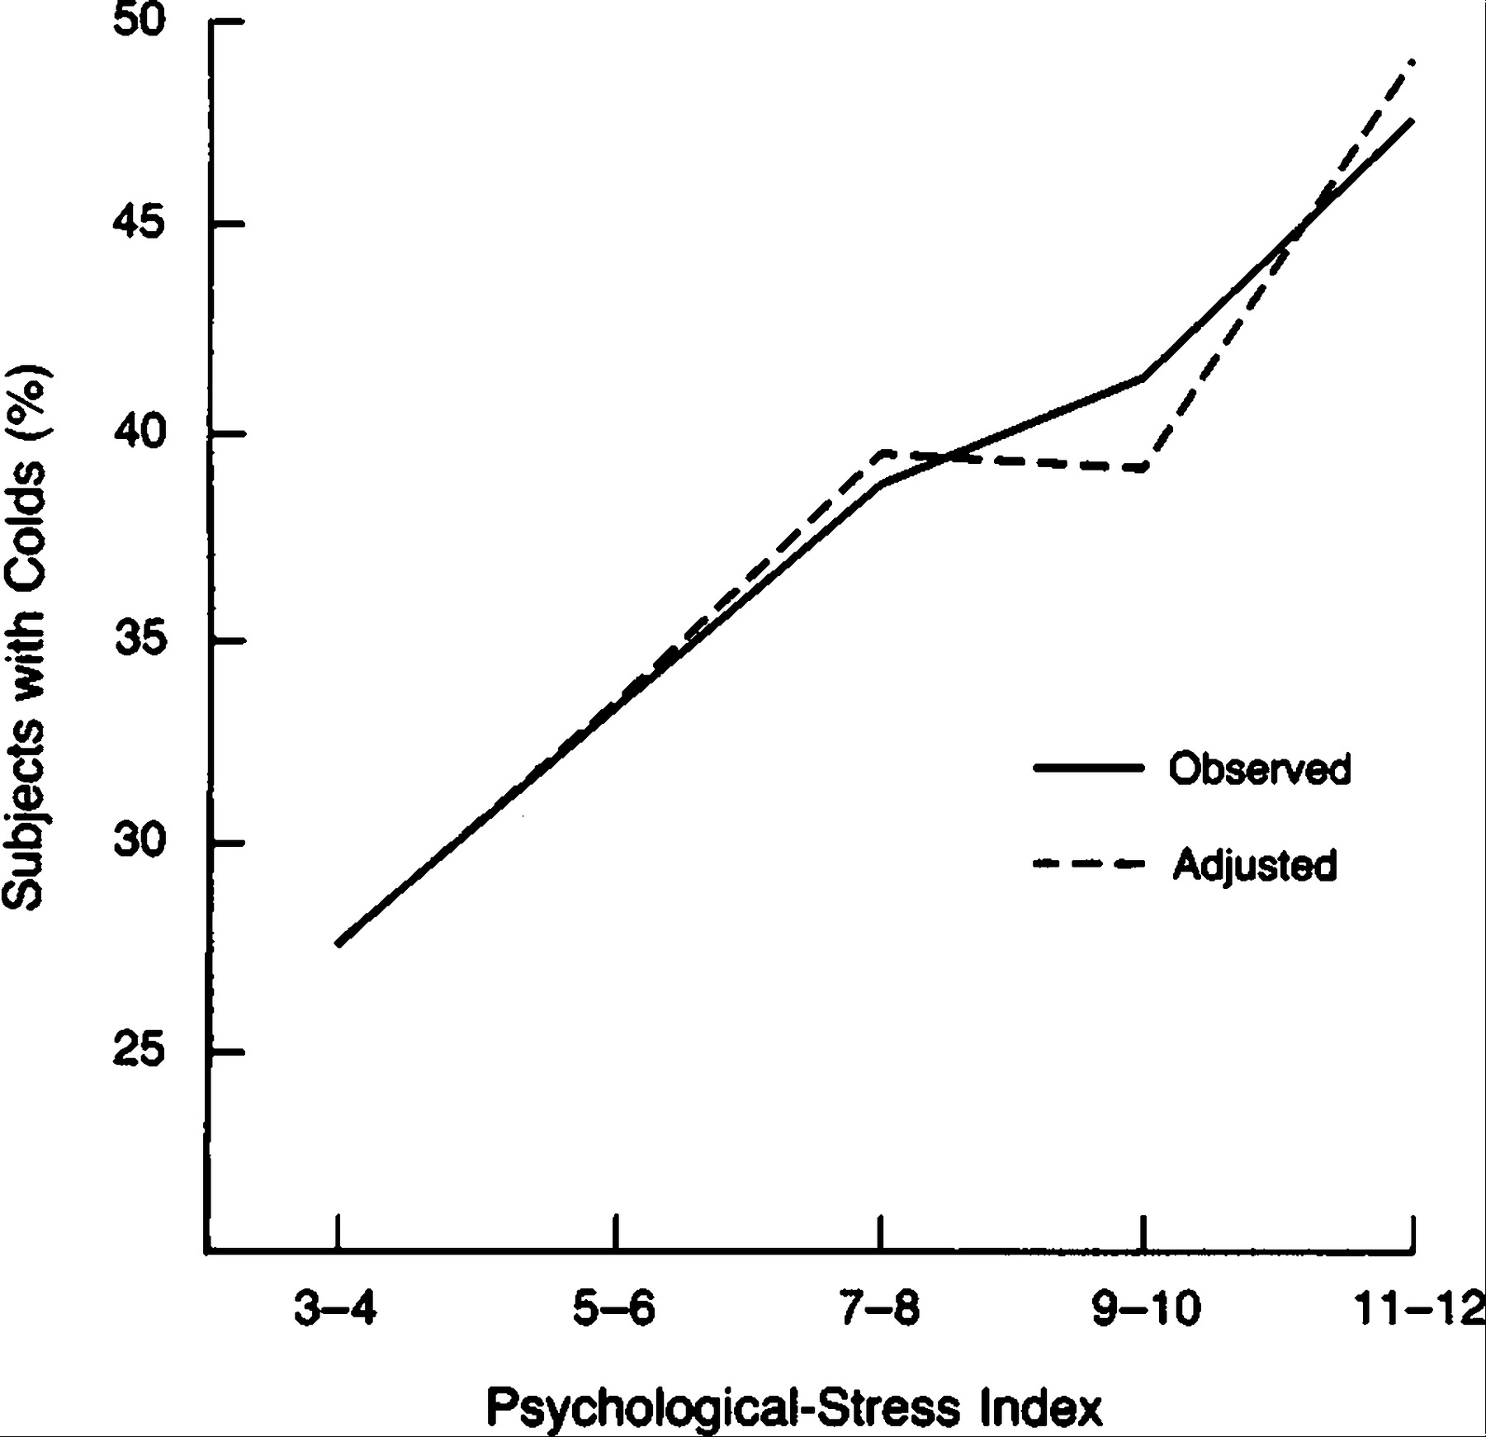
OK, But HSV isn’t COVID and PI/PA kids aren’t typical, so…why?
Psychological stress was associated in a dose-response manner with an increased risk of acute infectious respiratory illness, and this risk was attributable to increased rates of infection rather than to an increased frequency of symptoms after infection.
- A Coronavirus (COVID-229E) was in the family of tested agents
Cohen, Sheldon, David AJ Tyrrell, and Andrew P. Smith. "Psychological stress and susceptibility to the common cold." New England journal of medicine 325.9 (1991): 606-612.

Slide 11
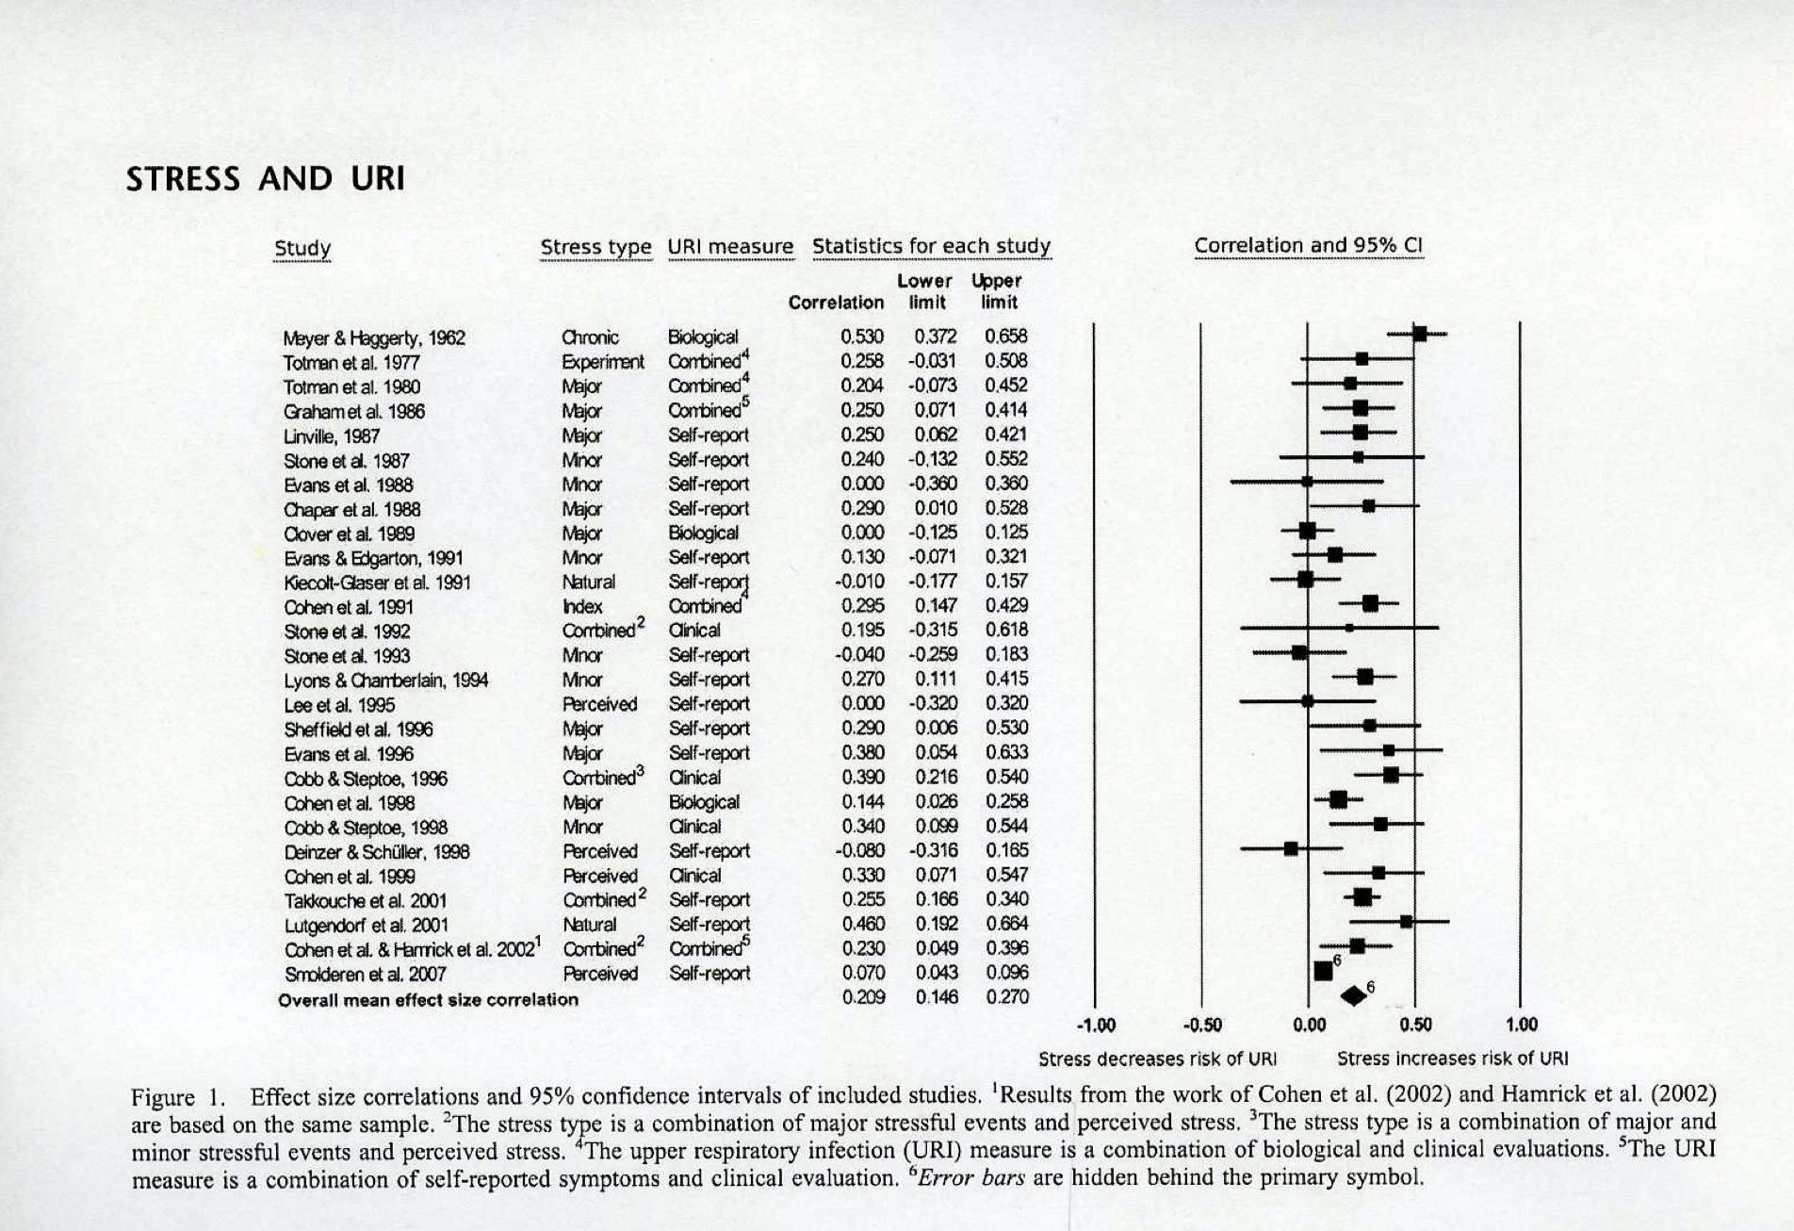
OK, but that was done like 30 years ago…

Slide 12
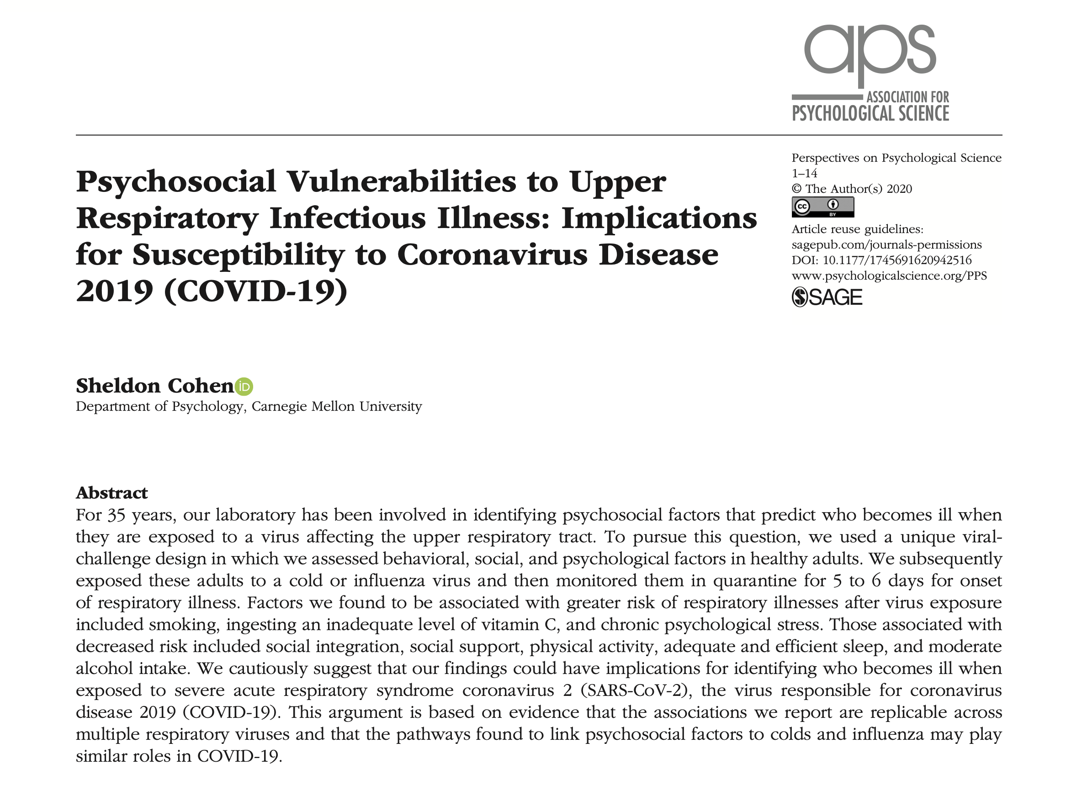
Fine. But COVID-19 isn’t the common cold

Slide 13
Well that’s a great thing to tell a zoom room full of super stressed people…
We do need to understand the magnitude of the relationship and potential moderators.

Slide 14
Chronic stressors
Child stress, symptoms, diagnosis, severity
Parent stress, symptoms, diagnosis, severity
Near term stressors

Slide 15
Proposal modifications since posting concept proposal
Measures of Chronic stress
ACEs
Life Events Checklist
Measures of Acute Stress
GIS and rural/urbanicity data
Household Chaos
Measures of Parent Stress and Severity
Parent report on self covid questionnaire Parts A and B
Measures of Child Stress and Severity
Parent report on child and child self covid questionnaire Parts A and B

Slide 16
Stress Measures
Theoretically Important!!
Available (in sufficient N) in ECHO now
Stable in ECHO
ACES
GIS
HOUSEHOLD CHAOS
GIS

Slide 17
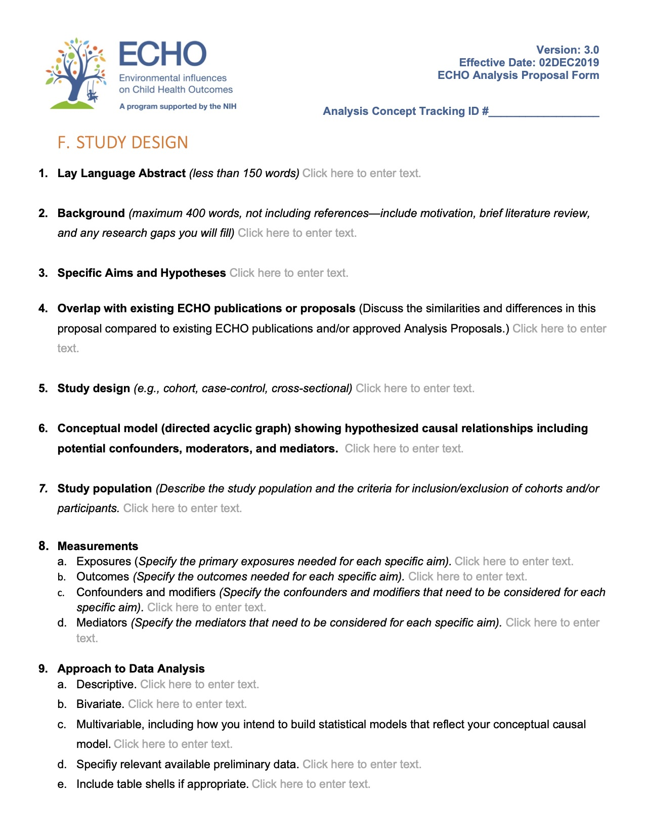
What to Resolve for the ECHO Analysis Proposal

Slide 18
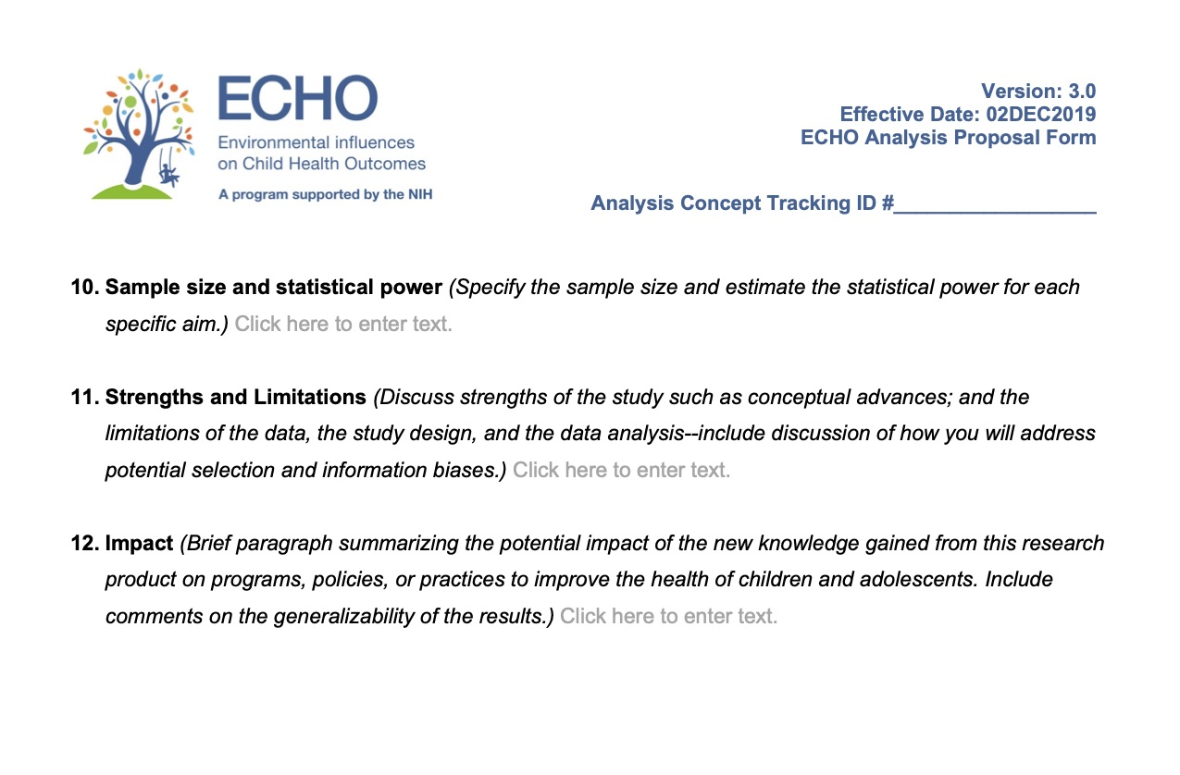
What to Resolve for the ECHO Analysis Proposal

Slide 19
Big Win?
We conceptualize solution-oriented Big Wins broadly as answers to specific research questions that leverage the unique features of ECHO, and that have the potential to yield far-reaching and long-term impacts on child health and disease. Specifically, their results have the potential to inform programs, practices, and policies that enhance children’s health.
-----------------
Solution orientation. Describe the specific intervention trial, other program, improvement of clinical or public health practice, guideline, or change in policy that the main result of your study will inform. (Enter text or enter Not Applicable) Click here to enter text.
End-user Stakeholder Needs. Identify the end-user stakeholder need that informs your answer to #1. Who is/are the end-user stakeholder(s)? How did you obtain information about their needs? Click here to enter text.
Innovation. Explain any novel concepts, approaches, or methodologies that you propose. Click here to enter text.

